Slide 1
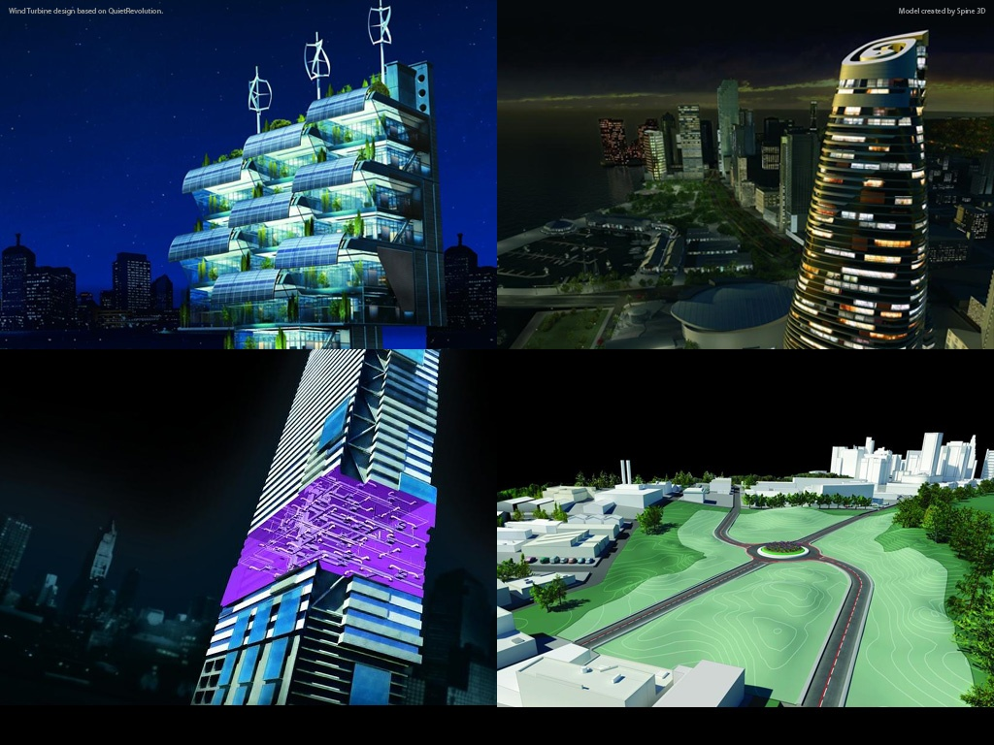
Autodesk AEC Developer’s Camp 2010 Analyzing Building Geometry using the Revit API
Scott Conover
Manager, Software Development, Revit API
Notes:
AEC Title

Slide 2
Objectives
See how Revit parameterizes 2D and 3D geometry
Learn how to understand and apply transformations of geometry
See the ray-tracing utilities assist with analysis of the physical relationships between elements in the Revit model
Learn techniques for measuring material quantities including areas and volumes.
Learn about a new geometry search tool in 2011

Slide 3
Agenda
3:15-3:30 | Geometry extraction
3:30-3:40 | Curve, edge, and face geometry
3:40-3:50 | Transformations
3:50-4:05 | Find references by direction
4:05-4:20 | Material quantity extraction, 2011 enhancements

Slide 4
Geometry extraction
Element.Geometry[Options]
ComputeReferences – populates the geometry reference
IncludeNonVisibleObjects – sets Revit to also return geometry objects which are not visible in a default view. Usually not useful (construction geometry) but some of this conditionally visible geometry represents real-world objects. One such example is the geometry of insulation surrounding ducts in Revit MEP.
DetailLevel –sets the detail level for the extracted geometry (default “medium”)
View – this sets the view that governs the extracted geometry. If set, supersedes “DetailLevel”. Geometry of an element can be very different for different views (for example, elements may be cut by a view’s section box, or families may have view specific representations)

Slide 5
Geometry extraction
Autodesk.Revit.DB.GeometryElement →
.Objects property→
Solid – a boundary representation made up of faces and edges
Curve – a bounded 3D curve
Instance – an instance of a geometric element, placed and positioned within the element
Instances contain another set of geometry:
GetSymbolGeometry() - the geometry represented in the coordinate system of the family
GetInstanceGeometry() - the geometry represented in the coordinate system of the project where the instance is placed
Instances can be nested

Slide 6
Geometry extraction
Other sources of geometry
LocationCurve – curve driven elements like walls and beams report their profile through this interface
References of dimensions – the references contain information regarding the geometry they point to
Structural AnalyticalModel – returns curves and faces representing the analytical model of structural elements
FindReferencesByDirection() – discussed later in this course

Slide 7
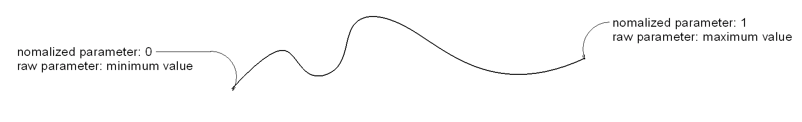
Curve parameterization
Normalized parameter: (0.0 →1.0). Easy to find locations based on curve segmentation (e.g. midpoint = 0.5)
Raw parameter: any minimum and maximum possible, obtain from Curve.EndParameter[int]. Easy to find locations based on distance along the curve. Also the only way to evaluate unbound and cyclic curves which don’t use normalized parameters at all.

Slide 8
Curve parameterization
Curve.Evaluate() – Returns the XYZ location of the given curve at a given parameter.
Curve.ComputeDerivatives() – Returns a Transform containing:
The XYZ location (.Origin)
The first derivative/tangent vector of the given curve (BasisX).
The second derivative/normal vector of the given curve (BasisY).
The binormal vector of the given curve, defined as the cross-product of the tangent and normal vector (BasisZ).

Slide 9
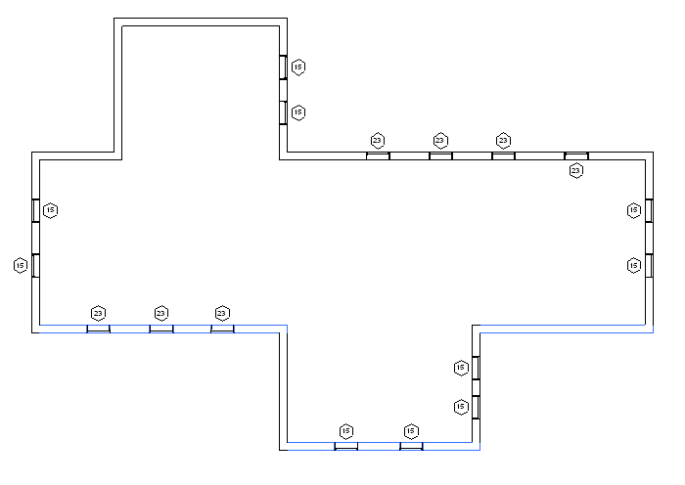
Curve parameterization – find south facing walls

Slide 10
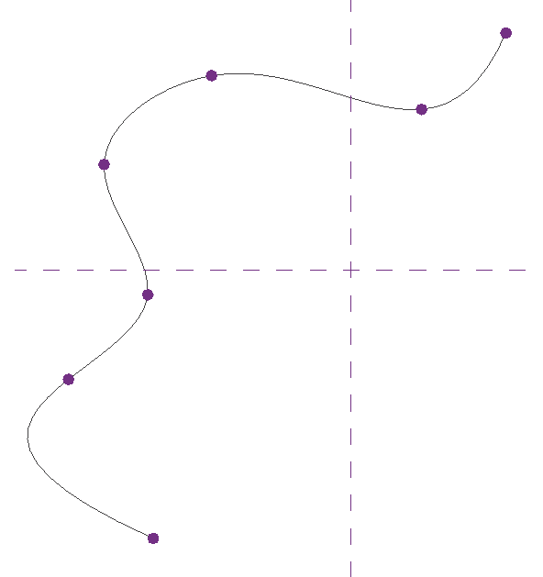
Curve types
Bound line
Unbound line (raw parameter only)
Arc (IsBound = true)
Circle (IsBound = false, raw parameter only, 0 to 2π)
Elliptical arc (IsBound = true)
Ellipse (IsBound = false, raw parameter only, 0 to 2π)
NURBS spline
Hermite spline

Slide 11
Curve analysis and processing
Intersect() - allows you compare two curves to find how they differ or how they are similar. Can identify:
Intersecting curves
Coincident curves/collinear lines
Overlapping curves
Identical curves
Totally distinct curves with no intersections
Project() - projects a point onto the curve and returns information about the nearest point on the curve, its parameter, and the distance from the projection point
Tessellate() - splits the curve into a series of linear segments, accurate within a default tolerance.

Slide 12
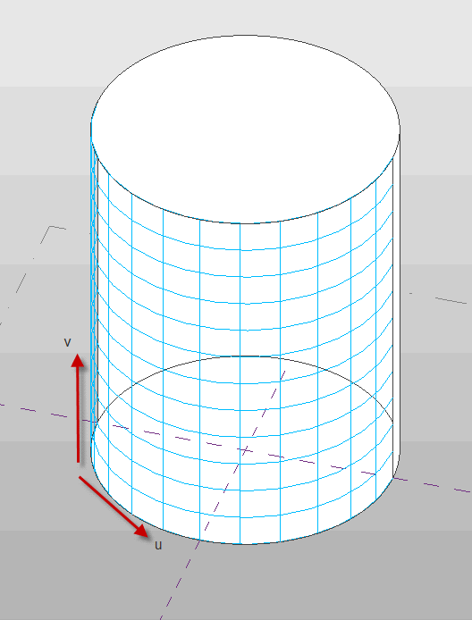
Face parameterization
Faces in the Revit API can be described as mathematical functions of two input parameters “u” and “v”, where the location of the face at any given point in XYZ space is a function of the parameters.
The U and V directions are automatically determined based on the shape of the given face.

Slide 13
Face parameterization
Face.IsInside() – identifies if the given parameter is within the boundaries of the face
Face.Evaluate() – Returns the XYZ location of the given face at a given UV value.
Face.ComputeDerivatives() – Returns a Transform containing:
The XYZ location (.Origin)
The tangent vector in the U direction at the given UV (BasisX)
The tangent vector in the V direction at the given UV (BasisY)
The normal vector of the given face at the given UV (BasisZ)

Slide 14
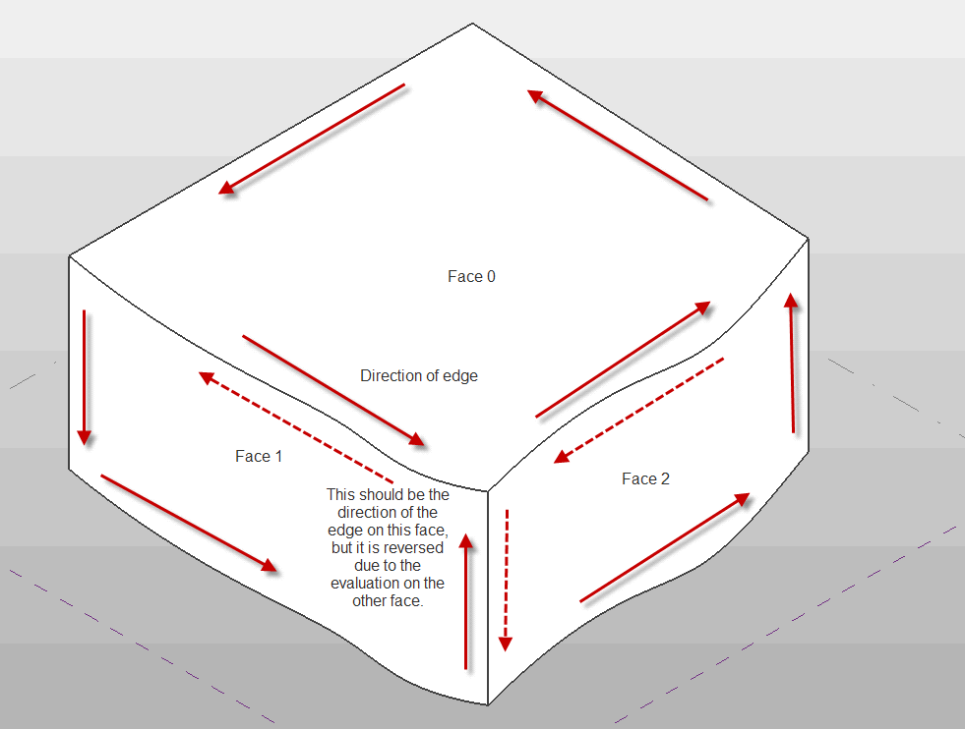
Edge parameterization

Slide 15
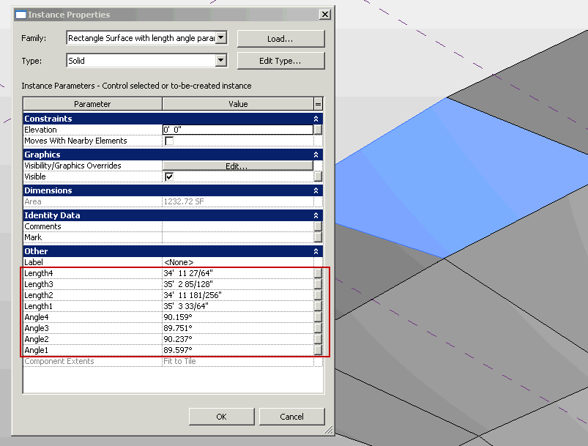
Edge parameterization- PanelEdgeLengthAngle

Slide 16
Face types
Plane – unit vectors in u and v
Cylinder – extrude circle along line
Cone – rotate line about axis
Revolved face – rotate curve about axis
Ruled face – sweep between profile curves/points
Hermite face – interpolated face

Slide 17
Face analysis & processing
Intersect() - allows you compute the intersection between a curve and face. Can identify:
The intersection point(s) between the two objects
The edge nearest the intersection point, if there is an edge close to this location
Curves totally coincident with a face
Curves and faces which do not intersect
Project() - projects a point onto the face and returns information about the nearest point on the face, its UV parameters, and the distance from the projection point
Triangulate() - splits the face into a series of triangular facets.

Slide 18
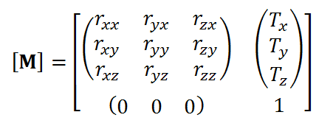
Coordinate transformations
Transform
Rotation (BasisX, BasisY, BasisZ)
Translation (Origin)
Scaling
Reflection
Transform.OfPoint() – applies transformation to a 3D point
Transform.OfVector() – applies rotational/reflectional/scaling transformation to a directional vector

Slide 19
Coordinate transformations
Obtain transforms from:
From the Instance class (the transformation applied to the instance)
From a Reference containing an Instance
From a Panel (curtain panel) element
From a 3D bounding box
From static properties on Transform (.Identity, .Reflection, .Rotation, .Translation)
By multiplying two Transforms together (Transform.Multiply())
By scaling a transform (and possibly its origin) (Transform.ScaleBasis() and Transform.ScaleBasisAndOrigin())
By constructing one from scratch (Transform constructor)

Slide 20
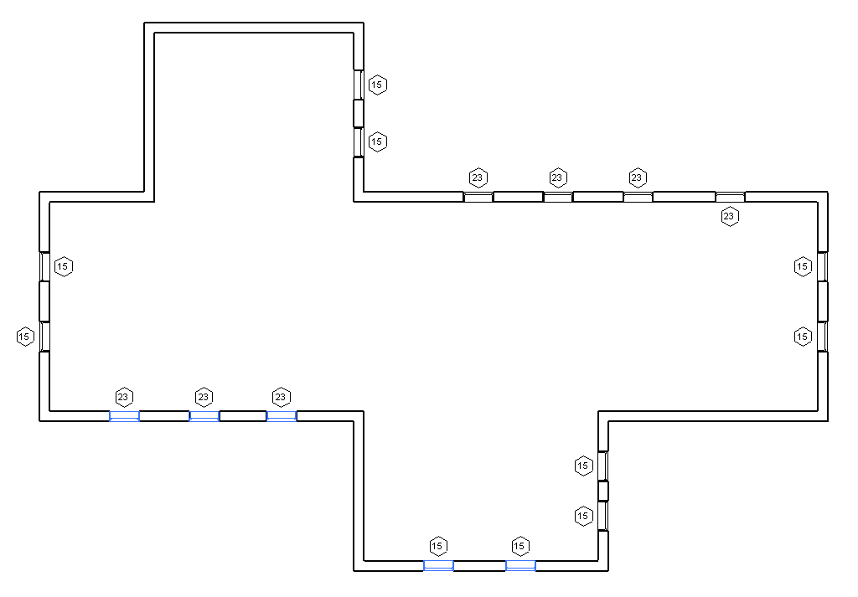
Transformation of instances – south facing windows

Slide 21
Nested instances
Instances may be nested inside other instances
Each instance has a Transform which represents the transformation from the coordinates of the symbol geometry to the coordinates of the instance
In order to get the coordinates of the geometry of one of these nested instances in the coordinates of the document, concatenate the transforms together using Transform.Multiply()

Slide 22
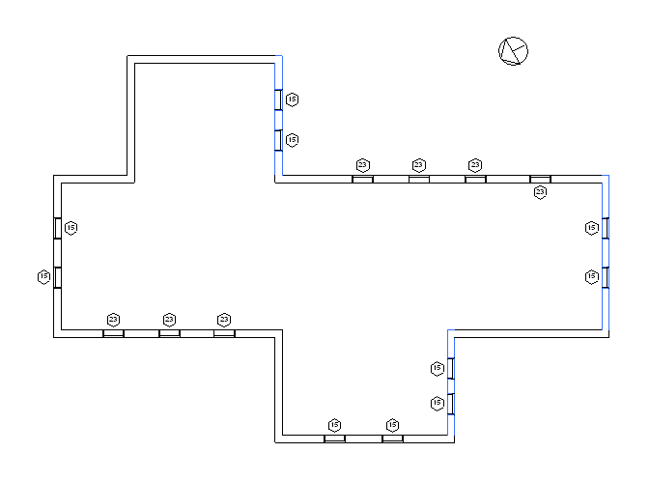
Project location
Document.ActiveProjectLocation
EastWest – east/west offset (X offset)
NorthSouth – the north/south offset (Y offset)
Elevation – the difference in elevation (Z offset)
Angle – the angle from true north
Find south-facing walls and
windows using project north:

Slide 23
FindReferencesByDirection()
Use Revit’s picking tools to find elements intersected with a ray cast in a given direction.
Inputs: ray origin and direction, 3D view
Returns: an array of References
Intersects 3D geometry only
The results reflect modifications to the input 3D view (section, visibility/graphics options)
Finds both elements and geometric references
Element references returned may not have a corresponding geometric object which is also intersected (for example, rays passing through openings in walls will intersect the wall and the opening element)
References will be found and returned only for elements that are in front of the ray (2010 documentation is incorrect)

Slide 24
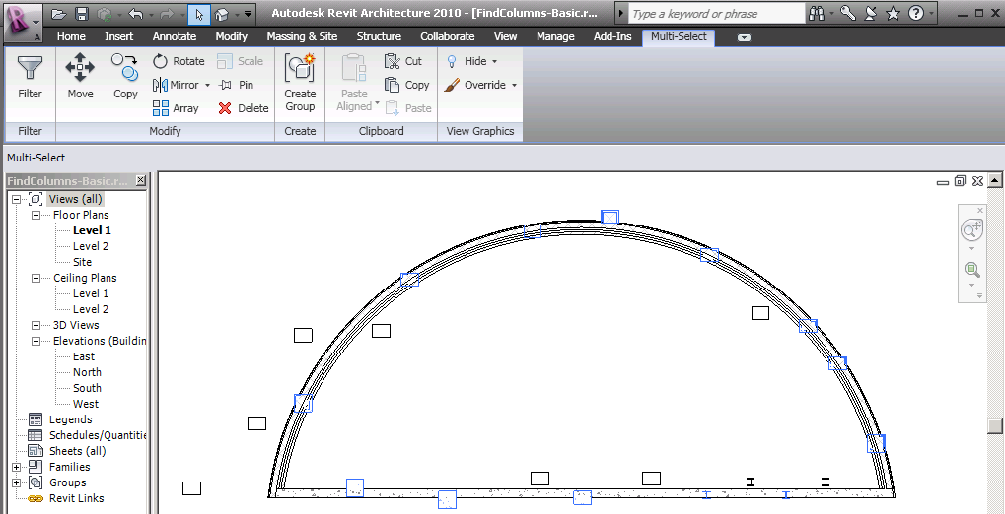
FindReferencesByDirection – element proximity

Slide 25
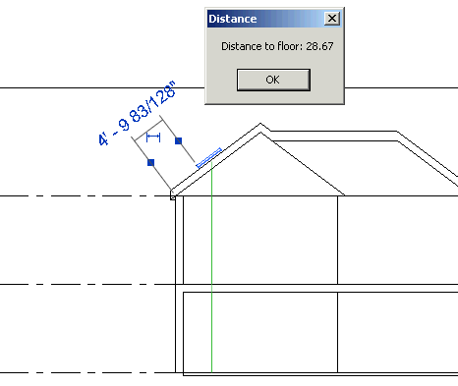
FindReferencesByDirection – measure distance

Slide 26
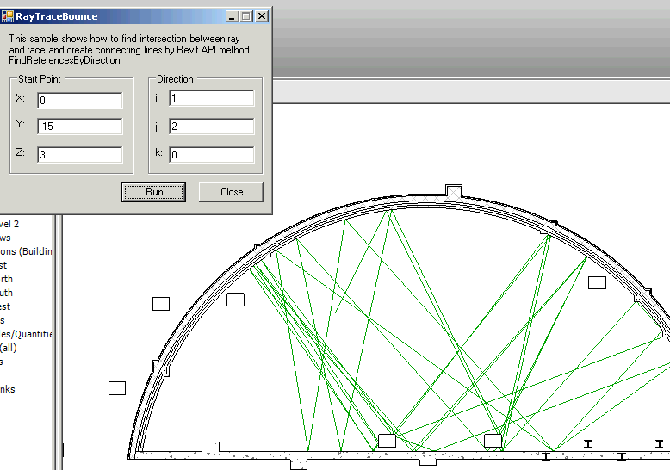
FindReferencesByDirection – ray bouncing analysis

Slide 27
Material quantity extraction
Element.Materials – obtains a list of materials within an element
Element.GetMaterialVolume() – obtains the volume of a particular material in an element
Element.GetMaterialArea() – obtains the area of a particular material in an element
Apply to categories of elements where Category.HasMaterialQuantities is true. (e.g. walls, roofs, floors, ceilings, stairs, plus 3D families where materials can be assigned to geometry of the family, like windows, doors, columns, MEP equipment and fixtures, and generic models)
Some members of the given categories still will not report material quantities. For example, curtain walls and curtain roofs will not report any material quantities themselves
Volumes and areas may be approximate in some cases

Slide 28
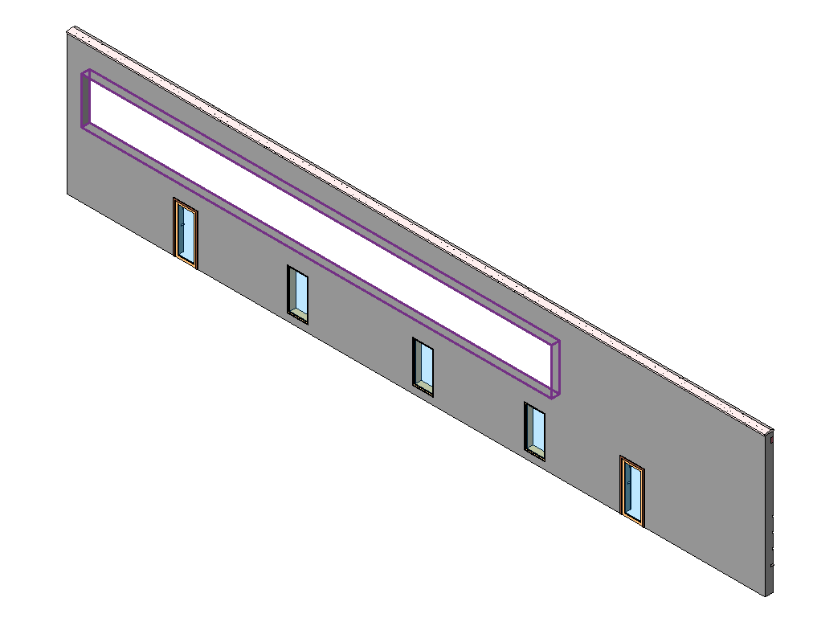
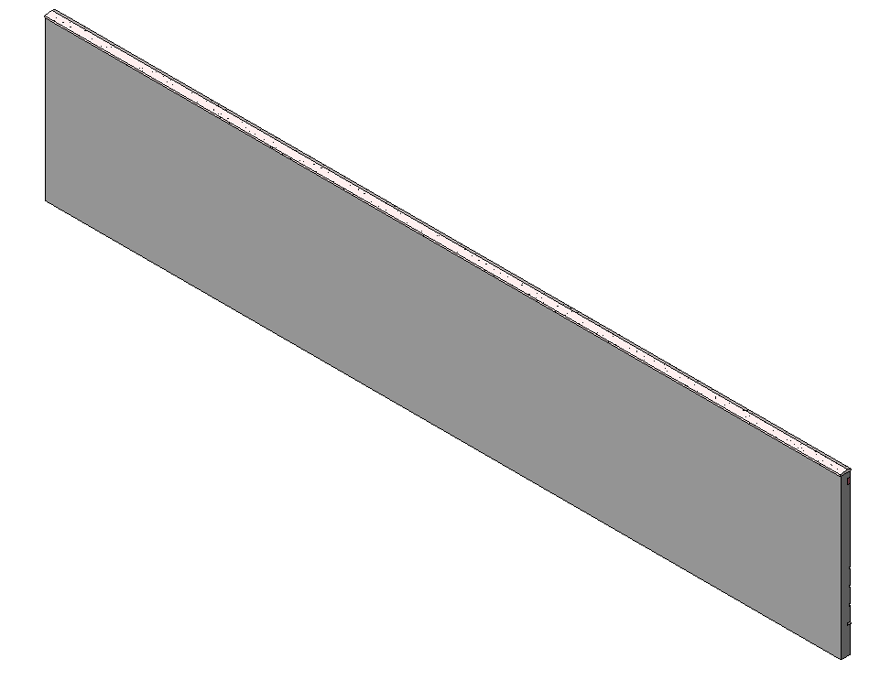
Temporary element suppression
How to get “gross material quantities” before elements are cut?
Use Delete() inside a temporary transaction. This regenerates the cut geometry of the parent element and produces the correct quantities. (Hide() only removes the cutting element from view, without regeneration of the parent geometry)

Slide 29
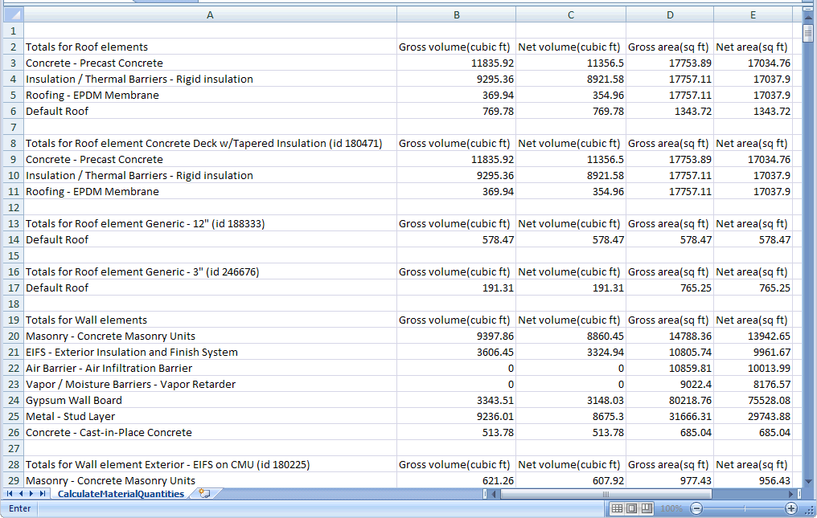
Material quantity extraction – gross and net material quantities

Slide 30
New Geometry tool in 2011
Use new BoundingBox filters to find elements
BoundingBox filters
BoundingBoxIsInsideFilter
BoundingBoxIntersectsFilter
BoundingBoxContainsPointFilter
BoundingBox filters use “Outline”, a class that represents the bounding box aligned with the major axes of the Revit model
So we can implement an alternate “find columns in walls” tool that supports:
Straight walls whose location curve aligns with a major axis

Slide 31
Summary
You have seen:
How Revit parameterizes 2D and 3D geometry, and how to use the API to extract and analyze it
How the Revit API uses transformations to represent geometry in different coordinate systems
How to use the ray-tracing utilities to analyze the physical relationships between elements in the Revit model
How to measure material quantities (both net values and gross values before material is removed)
The new 2011 BoundingBox filters can be used to roughly locate elements by their geometry

